Slide 1
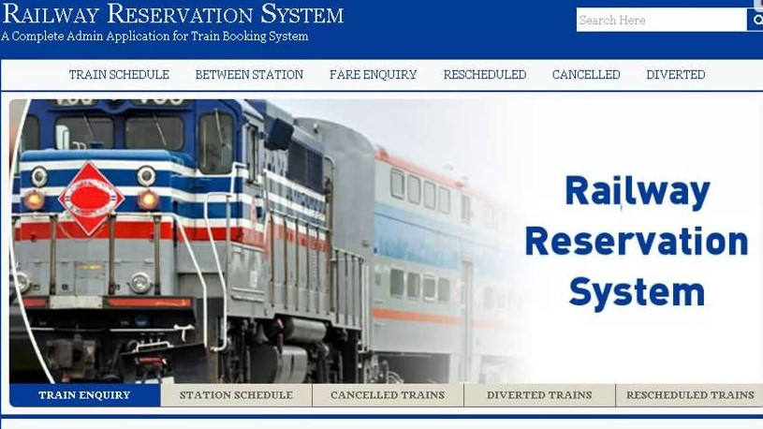

Slide 2
Group 6
Arslan Ali Daim Bscs14068
H.M.A Wajid Bscs14054
Azhar Ali Bscs14058
Danish Javed Bscs14028

Slide 3
Introduction
What is our System ?

Slide 4
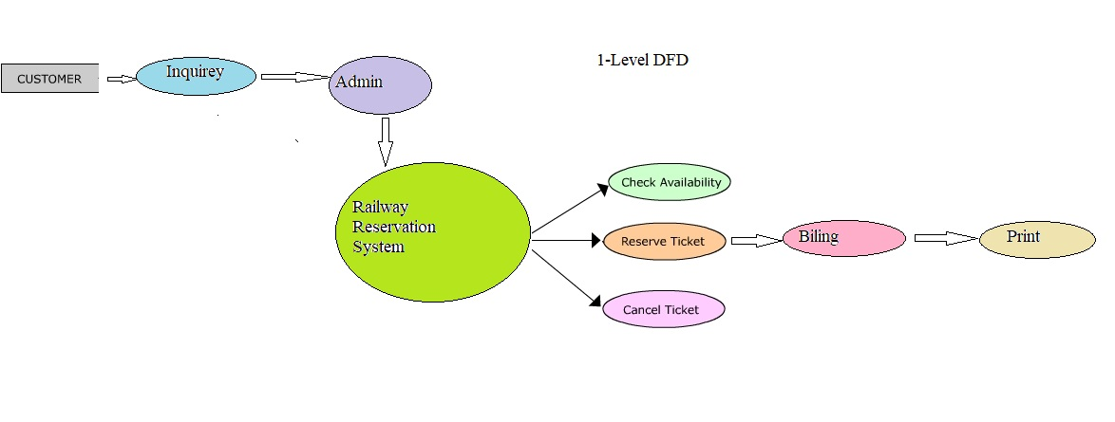
1 level DFD

Slide 5
Scope and Objectives
The main objective of this software is to facilitate administration of one Office.
Manual Data into computerized Data
More Fast accessible
Secure
Less workload

Slide 6
Features
Easy search for Required Data
Information of All trains and Their Schedules
Ticket reservation Form
Ticket Cancellation form
Print
Admin Panel

Slide 7
Correctness
Verification of available seats after reservations
Fair collection according to booking
Refund amount after ticket cancelation

Slide 8
Cohesion and coupling
Searching Seat for availability and Booking modules are coupled with each other because they always being used at the same time, coupling
Then Booking and payment modules are also use at the same time but for simplicity we will make them separate to have cohesive software, because payment module is related to accounts.

Slide 9
Future Work
Multiple offices & Connected to central Database
Android app for customer easiness

Slide 10
Incremental changes
At first, basic functionality system for one train with implementation of booking module.
Then in next step we will add ticket cancelation module.
Then we will scale our system for multiple trains.
Then we will add proper GUI into the system and so on.

Slide 11


